Slide 1




Social Work Day at the
United Nations
28 March 2011

Slide 2
www.globalsocialagenda.org

Slide 3
Abye Tasse - IASSW
Charles Abbey - ICSW
Gary Bailey – IFSW
David N Jones – 2012 International Programme Committee

Slide 4
3 International Organizations
IASSW
International Association of Schools of Social Work www.iassw.org
ICSW
International Council on Social Welfare
www.icsw.org
IFSW
International Federation of Social Workers www.ifsw.org

Slide 5
Vision for the Agenda process
To claim/reclaim the priority of social action
To create a collective voice of those in social work and social development and in social work education
To develop a process for setting a common agenda
To strategise the implementation of actions and to develop ways of monitoring, evaluating and improving our efforts

Slide 6
How are we doing this?
The three organisations (IASSW, ICSW, IFSW) have set up a common platform to help steer The Global Agenda process
And to support colleagues around the world in their deliberations and mobilisation initiatives

Slide 7
Outcomes from Hong Kong 2010
Over 3,000 participants met in Hong Kong and agreed to launch a global movement to address the major challenges of our societies
Major and relevant social issues that connect within and across our profession have been identified in The Agenda and provide a basis for consultation

Slide 8
Towards World Social Work Day 2012
First draft – Hong Kong - June 2010
Revised – September 2010
Consultation – October 2010
Review of responses – December 2010 – themes from feedback identified and disseminated (no revision at this stage)
Consultation – February 2011
World Social Work Day – 15 March 2011 - world-wide discussion

Slide 9
Towards World Social Work Day 2012
Information and communication strategy - Global organisations stimulate engagement and ownership
World Social Work Day 2012 - 20 March 2012
The Global Agenda officially presented to the United Nations Secretary General
Every Region submits The Agenda to continental organisations (African Union, ASEAN, European Union, Mercosur, etc.)
National groupings submit The Agenda to their governments

Slide 10
Universal Declaration of Human Rights - Article 25
“Everyone has the right to a standard of living adequate for the health and well-being of himself and of his family, including food, clothing, housing and medical care and necessary social services, and the right to security in the event of unemployment, sickness, disability, widowhood, old age or other lack of livelihood in circumstances beyond his control. Motherhood and childhood are entitled to special care and assistance. All children, whether born in or out of wedlock, shall enjoy the same social protection” (1948)

Slide 11
Millennium Development Goals (MDGs)
‘The MDG’s are global time-bound and quantified targets for addressing extreme poverty in its many dimensions - income, poverty, hunger, disease, lack of adequate shelter, and exclusion - while promoting gender equality, education, and environmental sustainability. They are also basic human rights - the rights of each person on the planet to health, education, shelter, and security as pledged in the Universal Declaration of Human Rights and the UN millennium declaration.’
Investing in Development: A Practical Plan to Achieve the Millennium Development Goals (2002)

Slide 12
Previous areas of local,national and global engagement
We are building on deep foundations
Poverty
Disaster prevention and intervention
Peace-building processes
Human rights
Challenges across the life cycle
Disabilities
Partnership with Service Users/ Consumers
Interdisciplinary practice and policy

Slide 13
The 4 themes
Social and economic inequalities within countries and between regions
Dignity and worth
Environmental sustainability
Importance of human relationships

Slide 14
Action since Hong Kong 2010
Since the 2010 Hong Kong conference, numerous initiatives have taken place across the globe
Feedback from the first consultation in 2010 demonstrated that issues identified in the draft Global Agenda are endorsed by the majority of the members who provided feedback

Slide 15
Be prepared for Social Work Day at the UN in 2012
Representation from many countries to hand over The Agenda
Co-ordinated hand-over ceremonies in regional and national centres

Slide 16
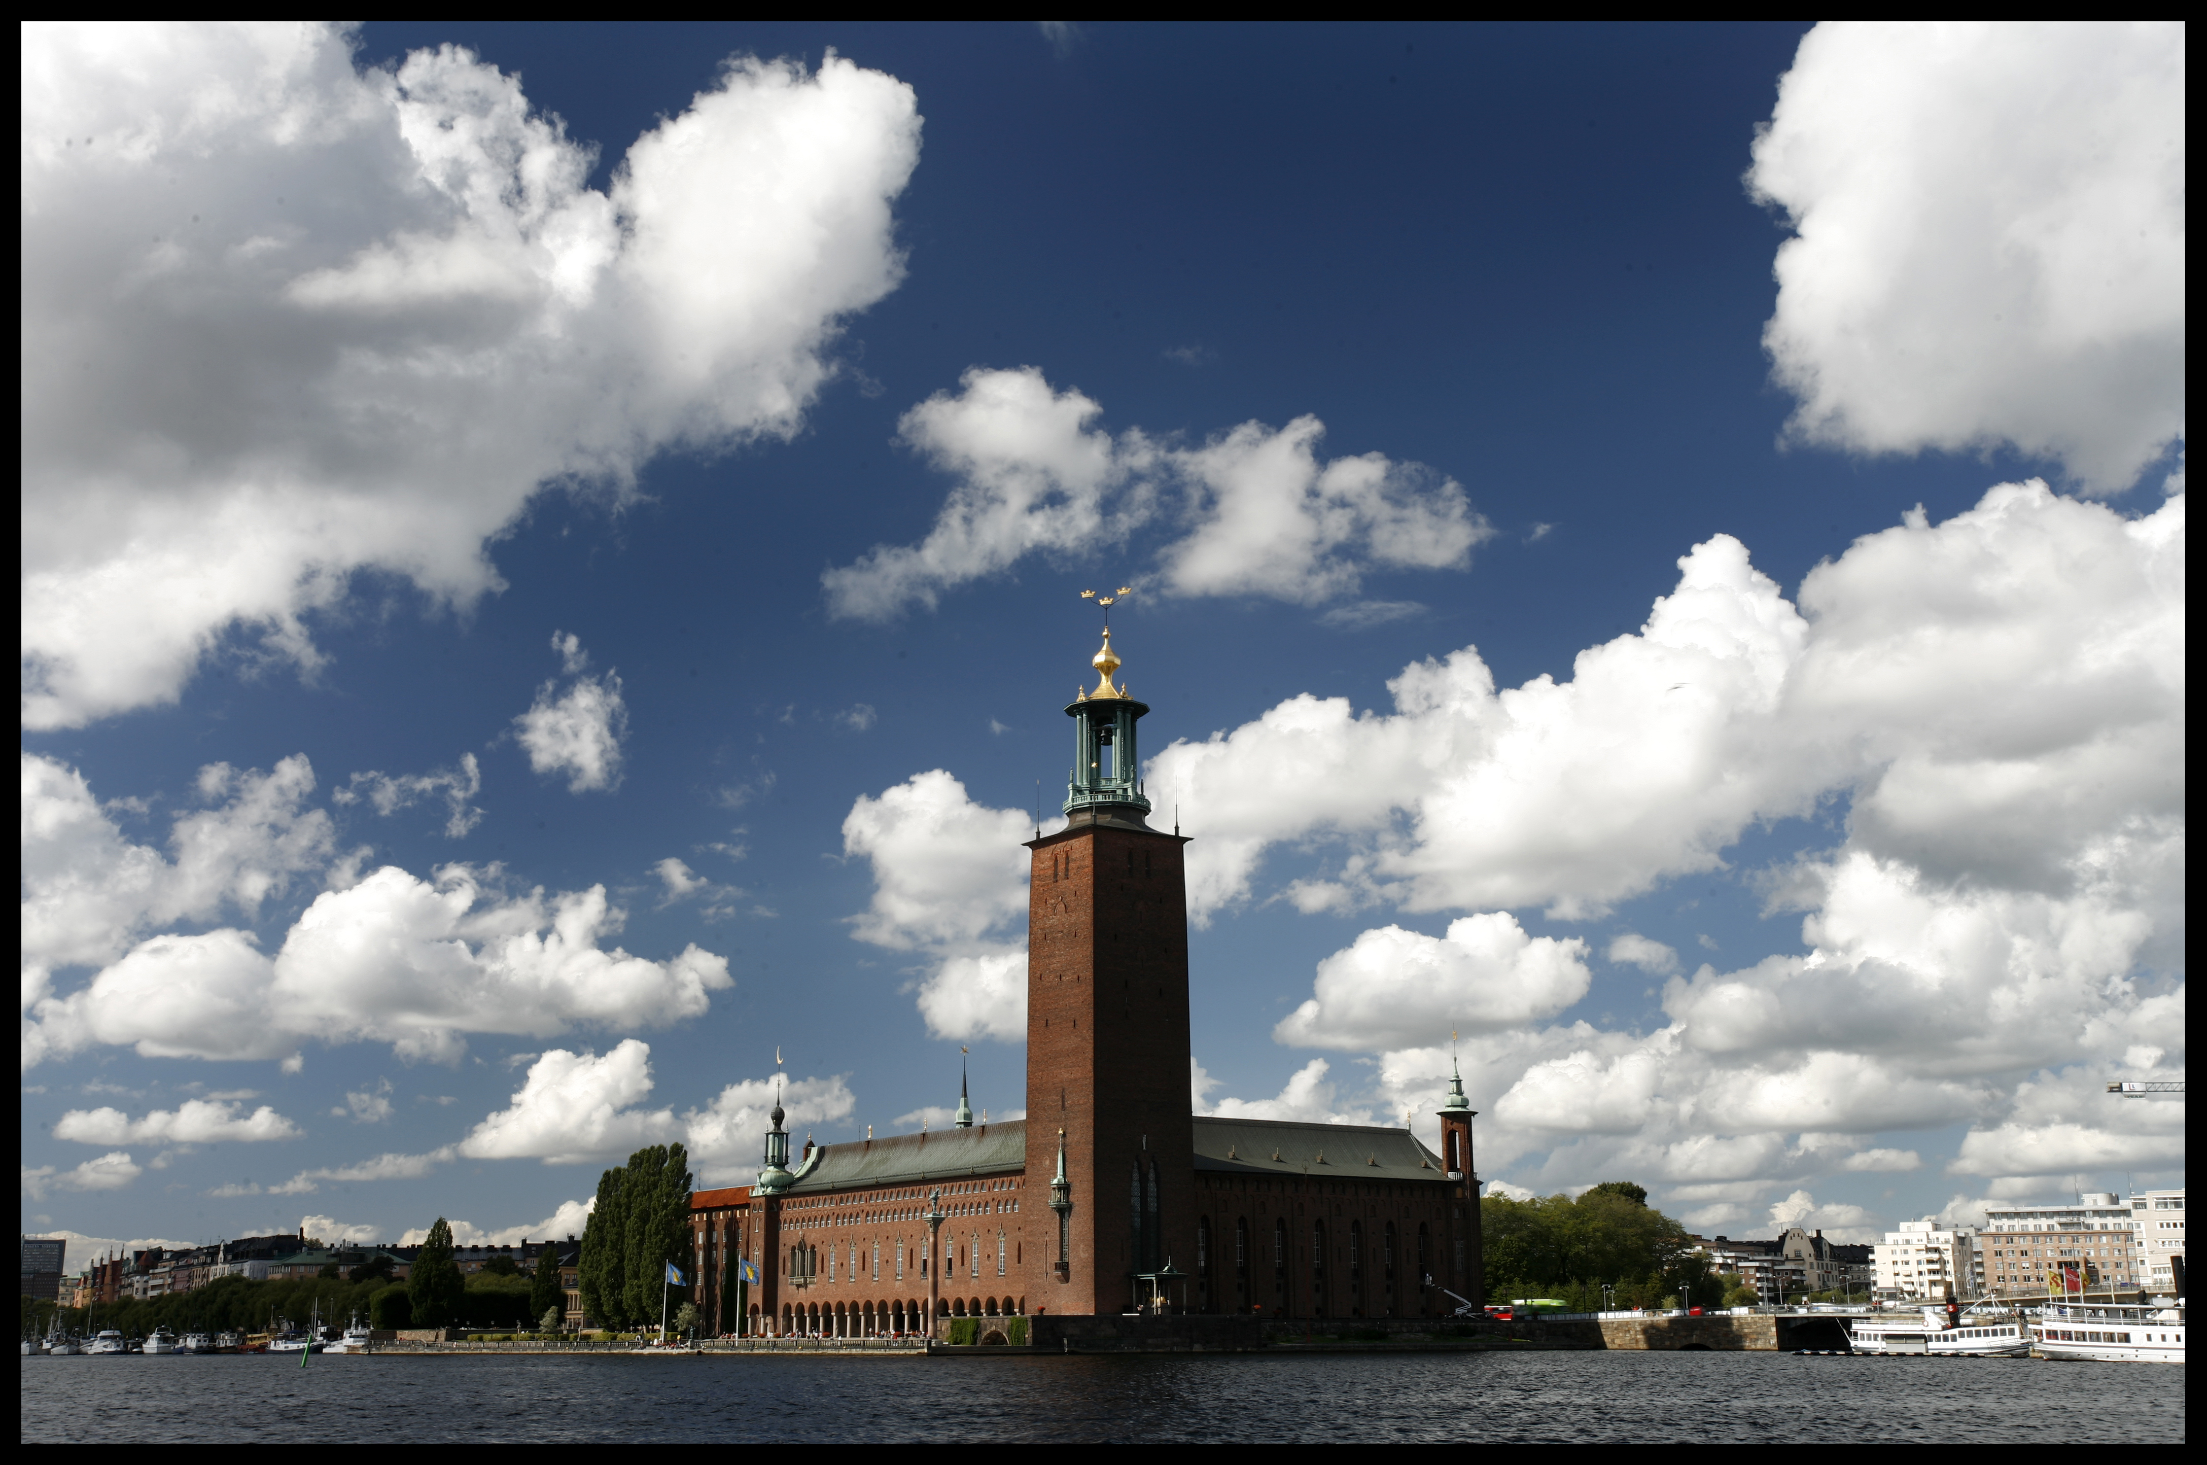
Be prepared for
Stockholm 2012
Thank you

Slide 17
Together we build the agenda
Together we face the challenge
Together we thrive
www.globalsocialagenda.org

